Slide 1
SECURITY & SAFETY EXHIBITIONS CONNECTING LOCAL & GLOBAL MARKETS

Slide 2
THE EXISTING NETWORK

Slide 3
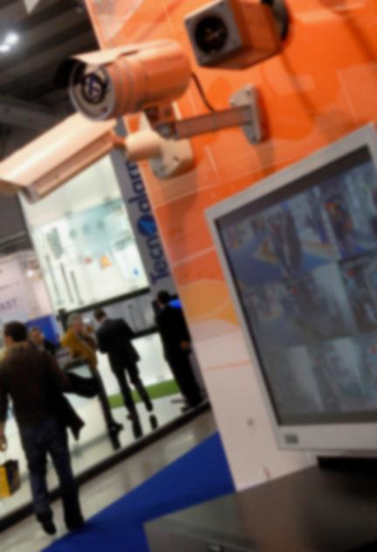
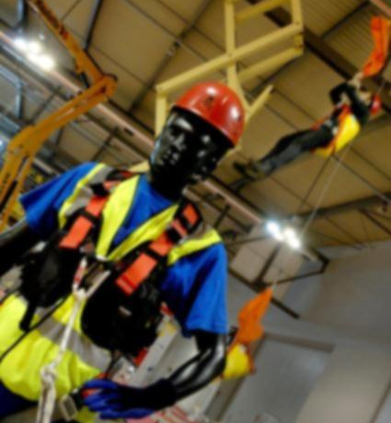
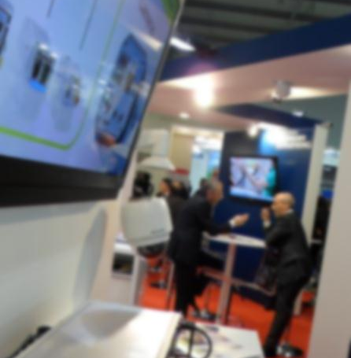
THE SECURITY SECTOR
Three events, a single Focus
We’ve already a performing and well defined platform…
EXPOSEC
San Paolo – Brazil
Annual, May
FISP
San Paolo – Brazil
Biennial, October
SICUREZZA
Milan – Italy
Biennial, November
Security
Safety
Security
Uniforms
Fire prevention
Health promoters
Automation
Chemicals
Collective protection equipment
Detectors
Equipment for work at height
Personal protection equipment
Measuring instruments
Signage and special vehicles
Anti-intrusion
Fire prevention and detection
Passive defence
Home & building automation
Intelligence and anti-terrorism
Local police and private security
Cyber and ICT security
NEW PRODUCTS 2014:
Safety (Fire prevention - extinction– PPE)
Road safety
Access controls
Central monitoring stations
Security + govern associations
CCTV
Corporate protection
Data security
Electronic security
Identification systems
Monitoring centrals
Residential security
Security locks and surveillance

Slide 4
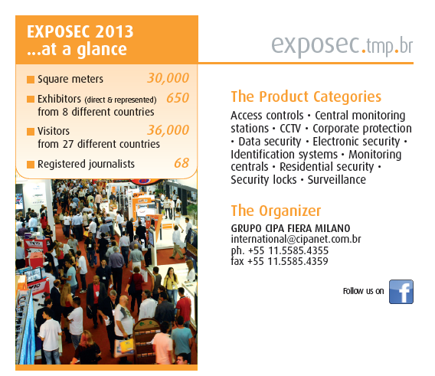
THE SECURITY SECTOR
*
Visitor
Administrator, analyst, buyer, Civil Guard, consultant, coordinator, detective, distributor, engineer, human resources, inspector, installer, instructor, manager, marketing, monitoring, owner, professor, representative, sector responsible, security agent, supervisor, technician
* = gross sqm

Slide 5
EXPOSEC – TREND 2012-2013
THE SECURITY SECTOR
 | 2012 | 2013
visitors | 35.000 | 36.000 | +2,78%
foreign | 300 | 375 | +20%
exhibitors | 675 | 650 | -3,70%
foreign | 150 | 200 | +25%

Slide 6
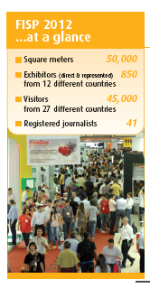
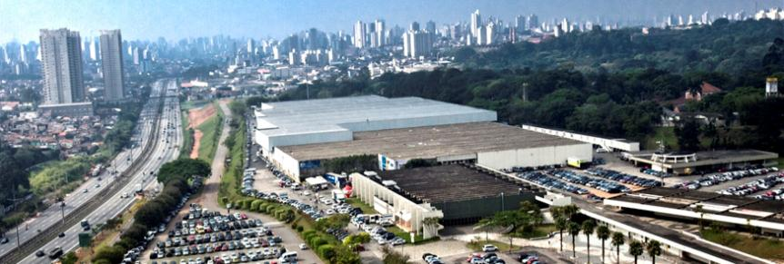
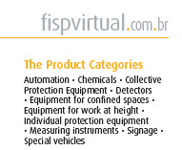
THE SECURITY SECTOR
*
Visitors
Dealer / retailer, director, fireman, hygienist, labor doctor and nurse, assistant, labor psychologist, labor safety assistant, labor safety engineer, labor safety technician, patrimonial security, phonoaudiologist, preventionist, risk inspector, safety manager, student, teacher.
* = gross sqm

Slide 7
FISP – TREND 2012-2010
THE SECURITY SECTOR
 | 2010 | 2012
visitors | 41.000 | 45.000 | +8,75%
foreign | 250 | 300 | +16,67%
exhibitors | 640 | 850 | +24,71%
foreign | 100 | 150 | +33,34%

Slide 8
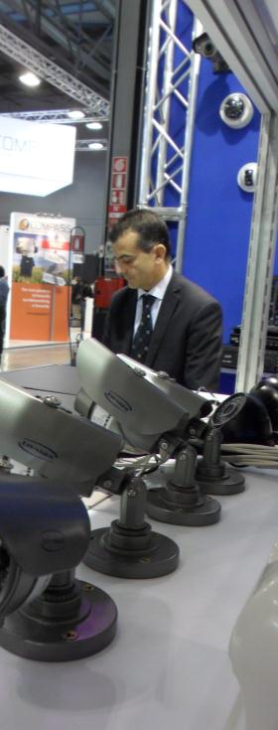
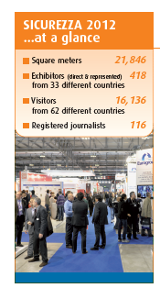
THE SECURITY SECTOR
*
Visitors
Installers, security & risk manager, safety manager, suppliers, system integrator, final users (banks, retail outlet, large retailers…), institution, police forces and private security
* = gross sqm

Slide 9
SICUREZZA – TREND 2010-2012
THE SECURITY SECTOR
 | 2010 | 2012
visitors | 13.665 | 16.136 | +18%
foreign | 953 | 1020 | +7%
exhibitors | 373 | 418 | +11%
foreign | 123 from 24 countries | 157 from 34 countries | +28%

Slide 10
THE GLOBAL OFFER
Security Industrial Solutions
Security
Civil
Solutions
Security
Commercial Solutions
Fire
Prevention
Systems
Personal
Protection
Equipment
Three different exhibitions, one shared target

Slide 11
Three Players, One Team, A Goal…
2 - 1

Slide 12
THANKS!

